Slide 1
Magnetic Fields and Electromagnetism

Slide 2
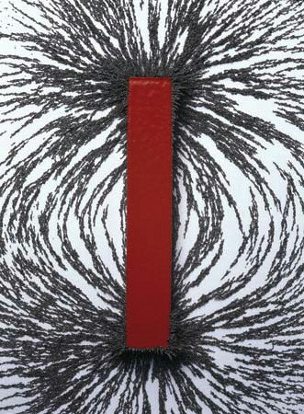
Magnetic Fields
In physics, a field is a region in which an object may experience a force.
In a gravitational field, objects with mass experience a force.
In an electric field, charged objects experience a force.
In a magnetic field, magnetic objects experience a force.
Magnetic fields are created by magnets, of which there are three types:
Permanent magnets
Temporary (a.k.a. induced) magnets
Electromagnets
Magnets always have two poles – a north pole and a south pole – near their ends. For this reason magnets are described as dipolar and their fields are sometimes called dipole fields.
In a magnetic field, tiny pieces of iron (called iron filings) show the field’s shape.
Notes:
Technically all magnets are electromagnets, but that’s a story for another day. Another year, actually.

Slide 3
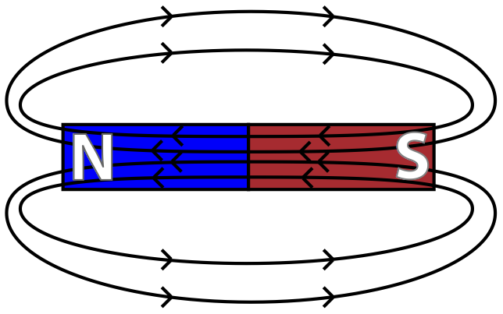
Drawing Magnetic Fields
Magnetic fields are represented by field lines with arrows that show the direction that the north end of a magnet would point if allowed to move freely.
However, these field lines always form closed loops, so the opposite is true inside the magnet. (This is not always shown.)
Similar to charge, unlike poles attract and like poles repel.
Notes:
You can also imagine them as the paths a north monopole would take, if such a thing existed. Also, this doesn’t really hold up inside the magnet.

Slide 4
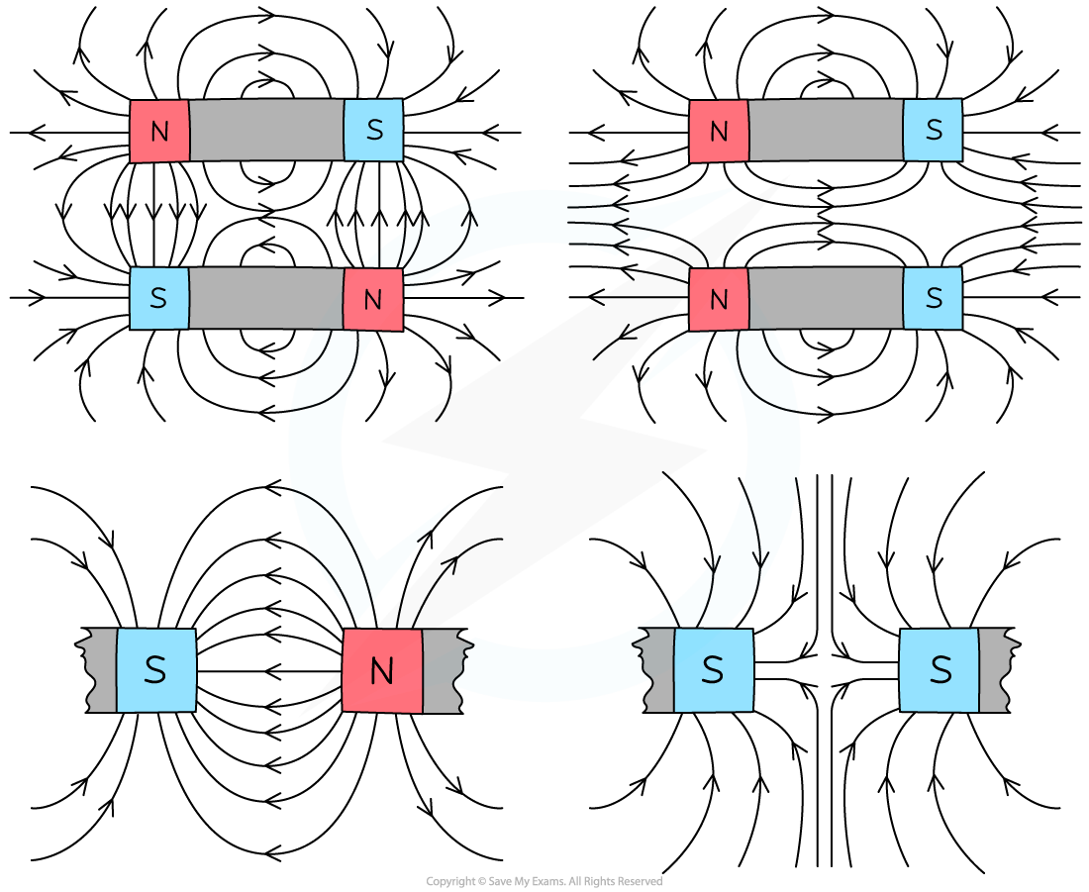
Drawing Magnetic Fields
Much like other field lines:
Field lines never cross
The density of the lines shows the strength of the field
Density / strength increases as you approach the poles

Slide 5
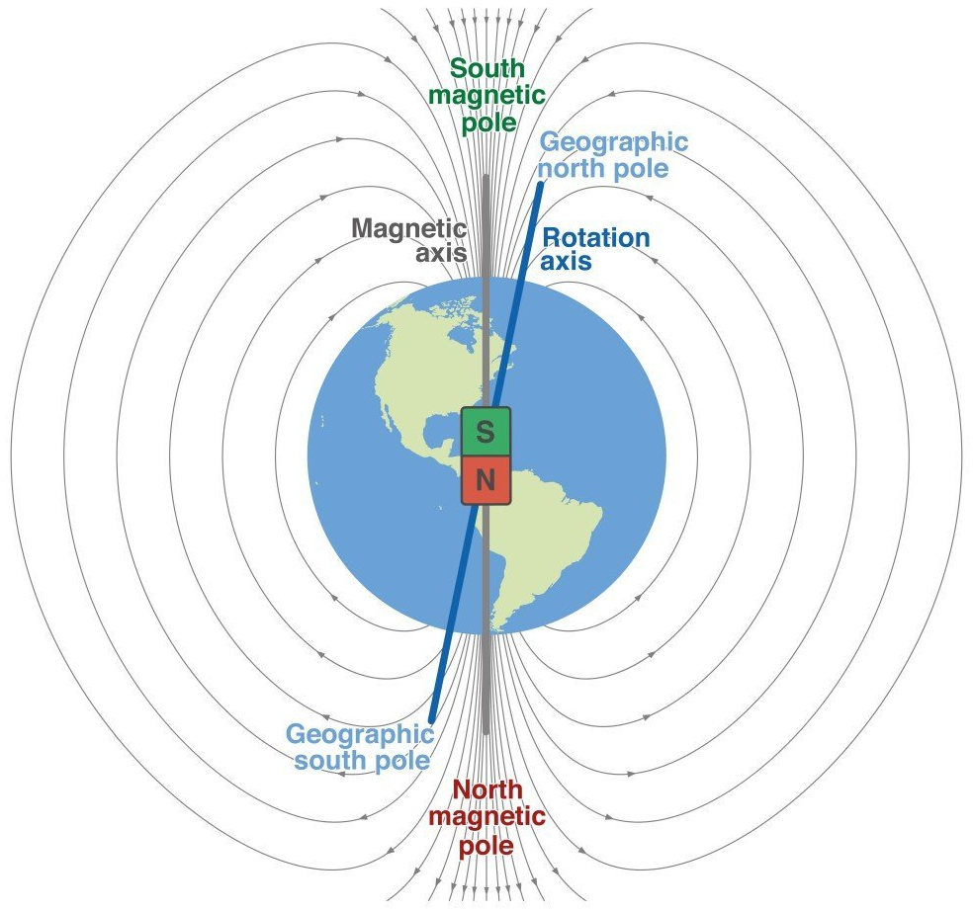
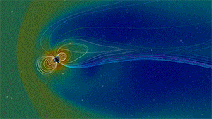
The Earth’s Magnetic Field
For compasses to work the way they do, the Earth’s magnetic field lines must point towards the North Pole – which means that the geographic North Pole is a magnetic south pole!
The two are actually hundreds of kilometres apart (almost 3000 km at the South Pole), and the magnetic poles are constantly moving.
Fun facts:
Geologists have found evidence that the Earth’s magnetic field has flipped randomly almost 200 times throughout its history – though this hasn’t happened for 780,000 years.
The Earth’s magnetic field protects us from a constant barrage of high-energy particles from the Sun.
The Earth’s magnetic field. Note that the field lines emerge at a greater angle the closer you are to the poles.

Slide 6
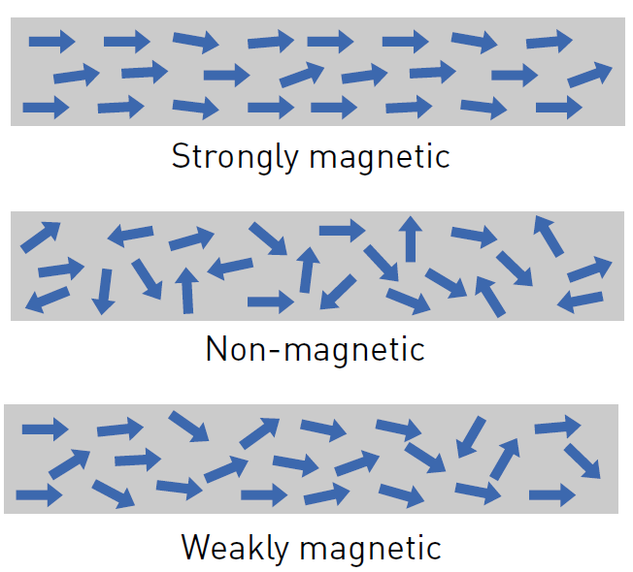
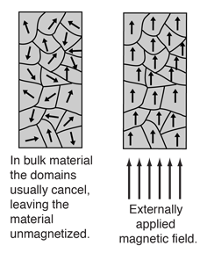
Magnetic Domains
Magnetic materials are made up of smaller magnetic parts called magnetic domains. The better aligned these domains are, the stronger the field the material produces.
Ferromagnetic materials (iron, nickel, cobalt, and gadolinium) have these domains, but they’re usually a mess. A magnetic field can straighten them out, making the metal into a temporary (induced) magnet.
This is how magnets attract items like nails and paperclips, and stick to whiteboards and fridges.
Most (but not all) types of steel are ferromagnetic due to their high iron content.
This magnetism is usually lost when the field is removed, but under the right conditions the domains will stay lined up, leaving the metal as a permanent magnet.

Slide 7
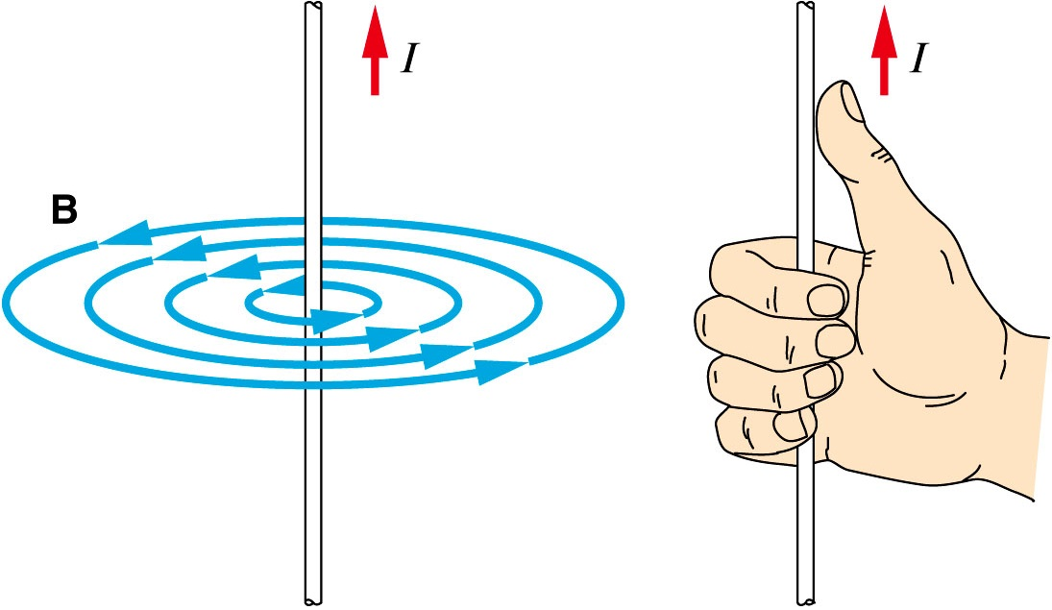
Current Carrying Conductors
Magnetic fields are also produced by the movement of charged particles – usually electrons in wires.
The simplest example of this is a single straight wire, which produces a magnetic field of concentric circles when current flows through it.
The direction of these field lines can easily be predicted using the right hand rule.
Note that:
I here is the direction of conventional current (positive to negative), not electron flow.
This is not a dipole field.

Slide 8
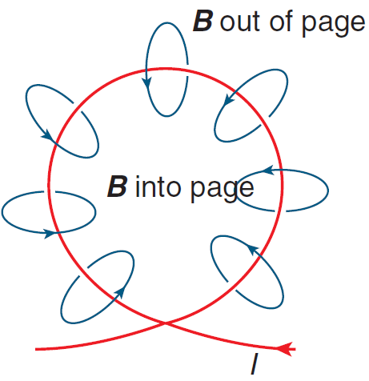
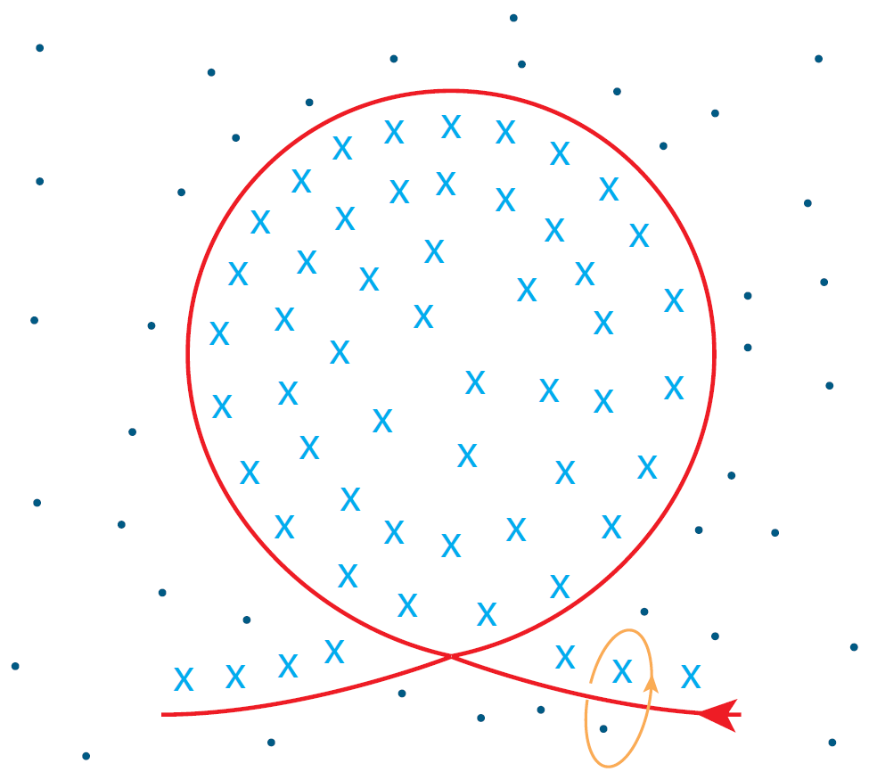
Current Carrying Conductors
If this wire is formed into a loop, a dipole field is formed as the field lines converge.
When representing a three-dimensional field, lines coming out of the page are shown as dots and lines going into the page are shown as crosses.
This resembles a 3D ‘arrow’ coming towards you or going away from you.

Slide 9
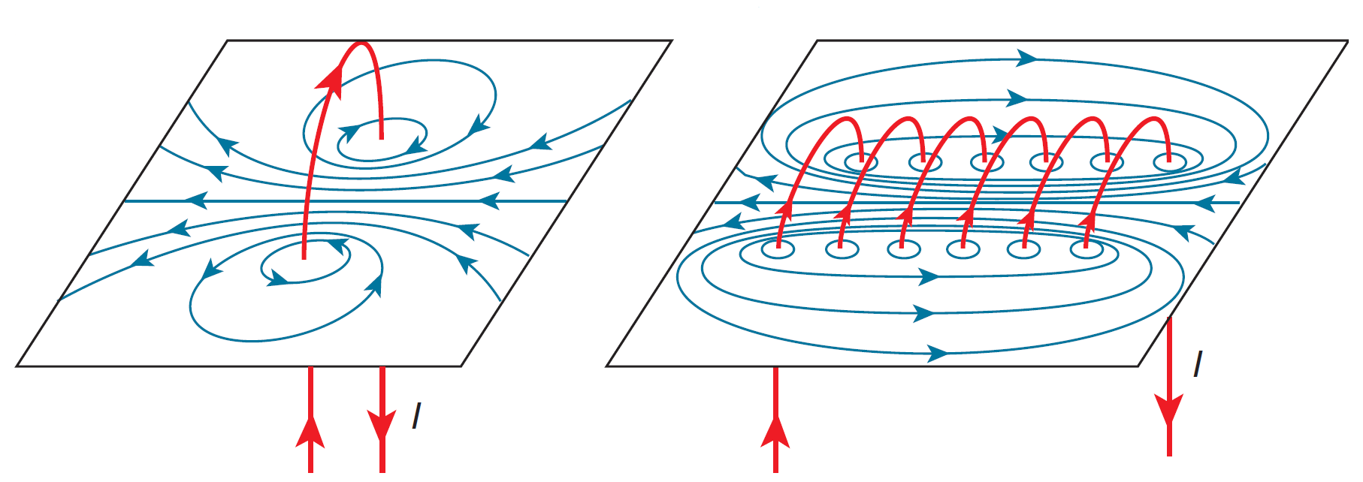
Current Carrying Conductors
Multiple loops can be made from the same wire, forming a coil known as a solenoid. Solenoids produce much stronger magnetic fields than single loops.

Slide 10
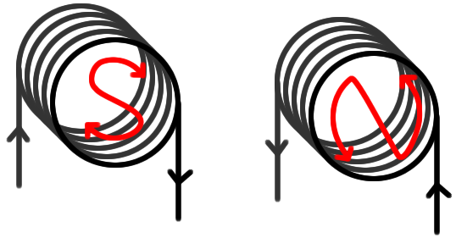
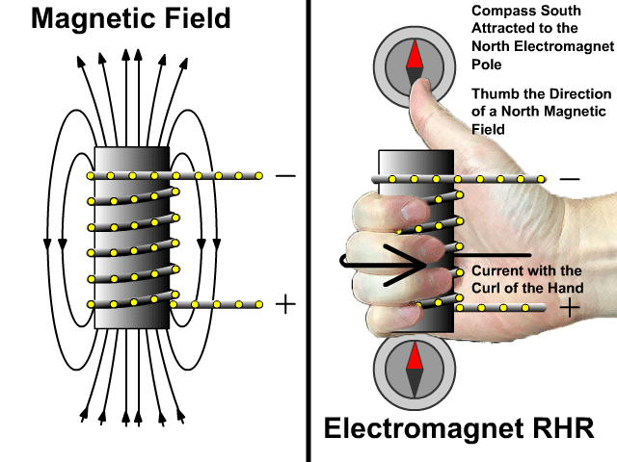
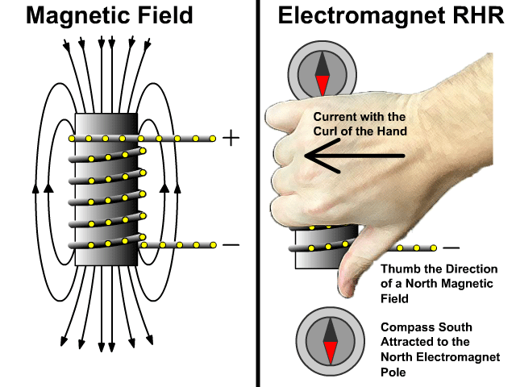
Current Carrying Conductors
Solenoids often have a ferromagnetic material placed inside them to further increase the strength of the magnetic field they produce. This arrangement is what we call an electromagnet.
The right hand rule can be used to determine the north pole of a solenoid or electromagnet.
You can also visualise the current from either end.

Slide 11
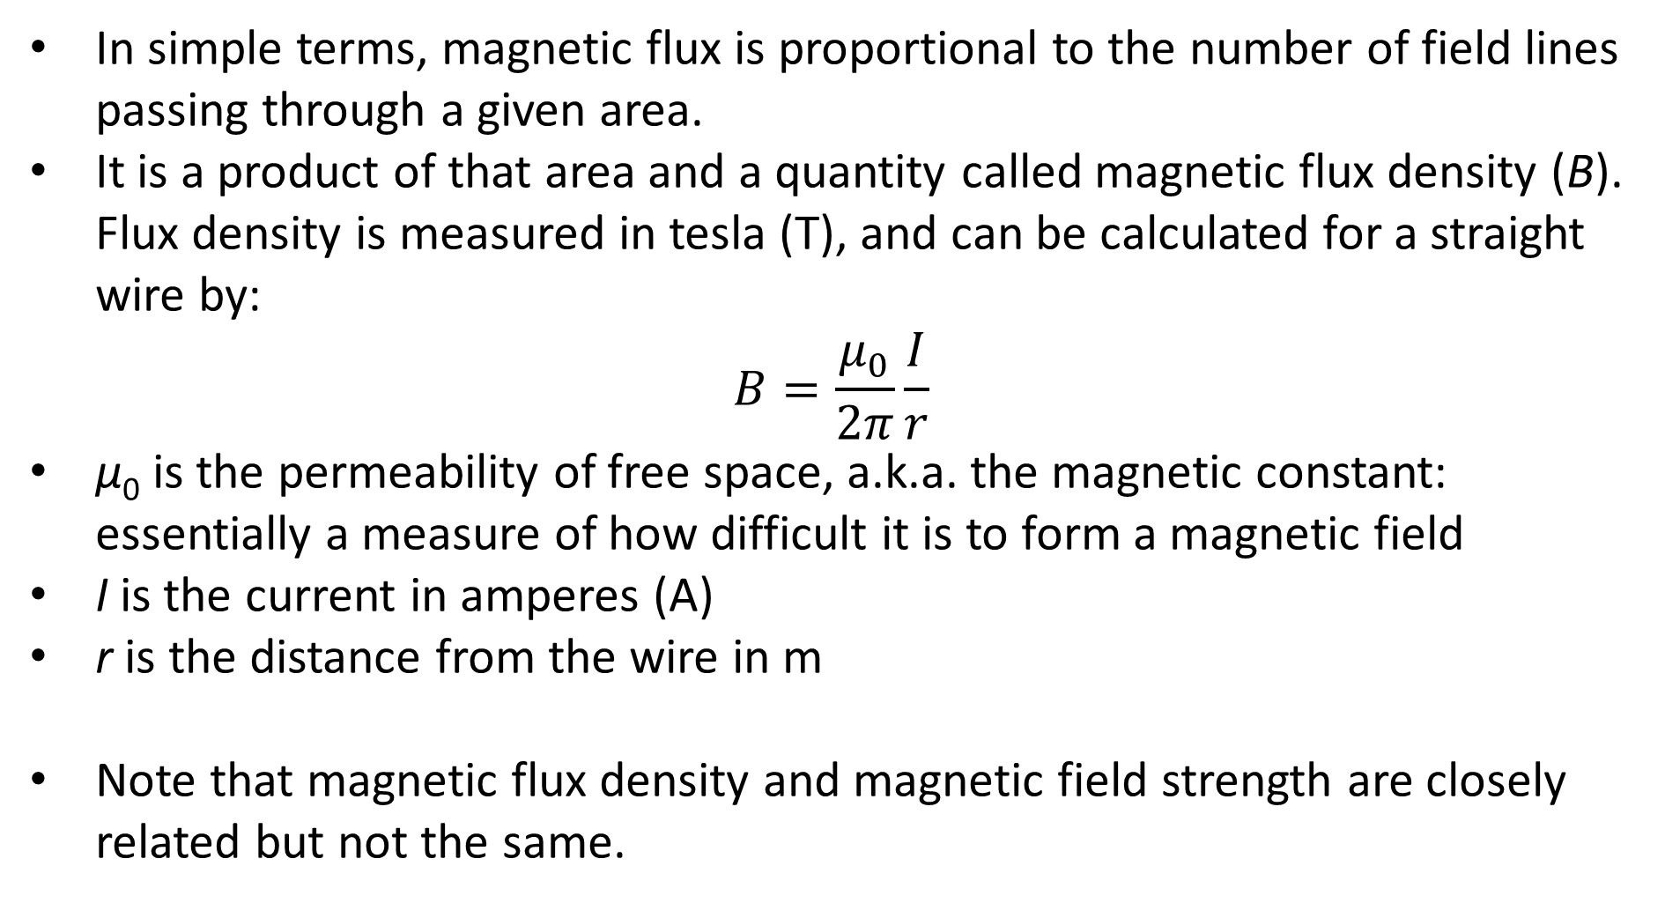
Magnetic Flux
In simple terms, magnetic flux is proportional to the number of field lines passing through a given area.
It is a product of that area and a quantity called magnetic flux density (B). Flux density is measured in tesla (T), and can be calculated for a straight wire by:
$$B=\frac{μ_{0}}{2π}\frac{I}{r}$$
μ₀ is the permeability of free space, a.k.a. the magnetic constant: essentially a measure of how difficult it is to form a magnetic field
I is the current in amperes (A)
r is the distance from the wire in m
Note that magnetic flux density and magnetic field strength are closely related but not the same.

Slide 12
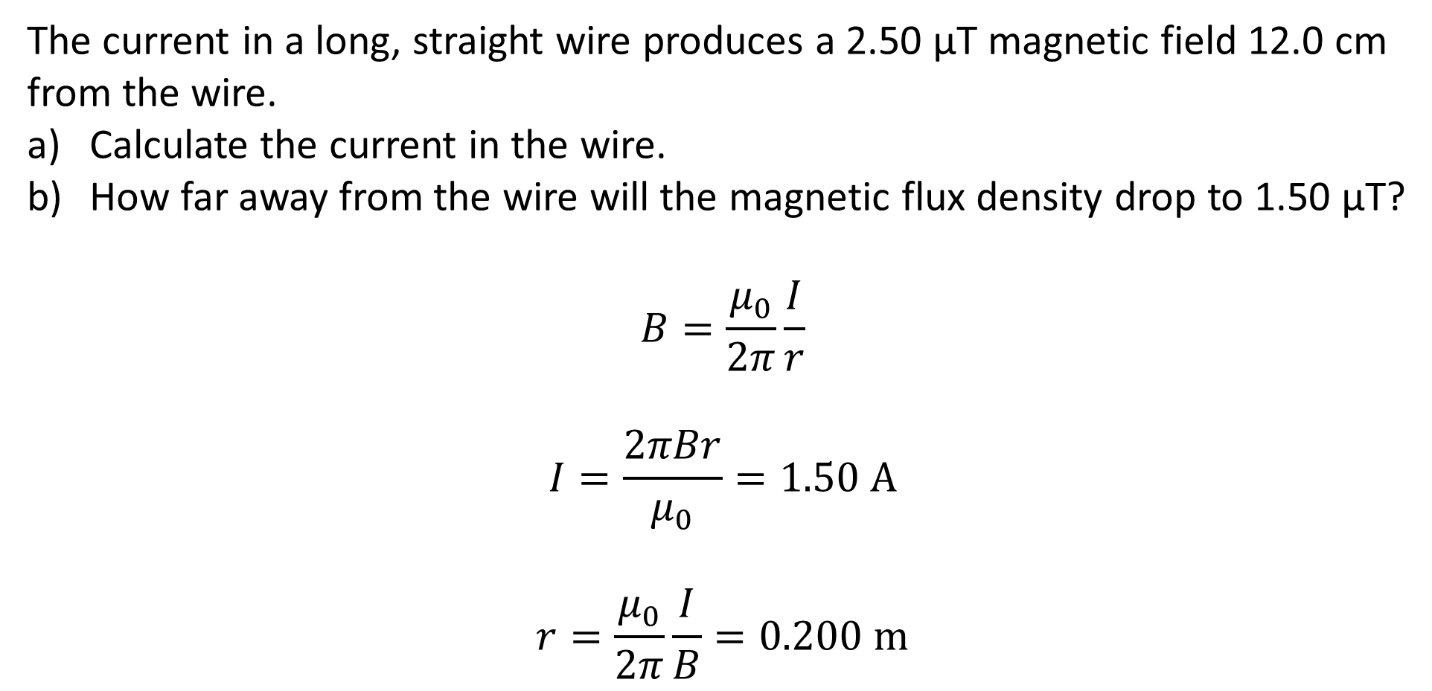
Example #1
The current in a long, straight wire produces a 2.50 μT magnetic field 12.0 cm from the wire.
Calculate the current in the wire.
How far away from the wire will the magnetic flux density drop to 1.50 μT?
$$B=\frac{μ_{0}}{2π}\frac{I}{r}$$
$$I=\frac{2πBr}{μ_{0}}=1.50 \text{A}$$
$$r=\frac{μ_{0}}{2π}\frac{I}{B}=0.200 \text{m}$$

Slide 13
Example #2
A sensitive experiment is being conducted in a region where the Earth’s magnetic field is declined at 19.0° and has a flux density 58.0 μT.
In which hemisphere is the experiment being conducted?
Calculate the component of the Earth’s magnetic flux density parallel with the surface in this region.
Notes:
North – in the south it would be inclined.
54.8 μT

